Slide 1

Author: Denis Hovsepian
Course: “Relq”
Date: November 2024
Customer Retention and Churn Analysis

Slide 2


Project Goal
Project Description:
This project aims to conduct an in-depth analysis of customer churn to uncover key factors that lead customers to leave the company. Customer churn is a significant challenge, especially in highly competitive markets. By understanding the reasons behind churn, the company can better retain customers through improved marketing strategies and increased loyalty.
2. Objective:
"Analyze customer data to identify common characteristics of those who are prone to churn. Based on this analysis, a targeted retention strategy can be developed to help increase company profits by reducing churn rates."
Customer Retention and Churn Analysis

Slide 3
3. Key Analysis Questions:
What are the primary causes of customer churn?
What customer characteristics are associated with a higher likelihood of churn?
Which services and products influence customer retention?
Outcome:
The analysis will help the company identify areas for improvement in business processes and customer engagement strategies, ultimately supporting proactive efforts to prevent customer churn in the future.

Slide 4


Data
Data Source:
"The data used in this project was obtained from Kaggle (https://www.kaggle.com/datasets/blastchar/telco-customer-churn), a popular platform that provides open datasets for data science and machine learning. Using this dataset, the project investigates customer churn."
Dataset Description:
The dataset includes information about the company's customers, containing around 7,000 rows and approximately 21 columns. These columns cover demographic, analytical, and financial details about each customer, with each row representing an individual customer.

Slide 5
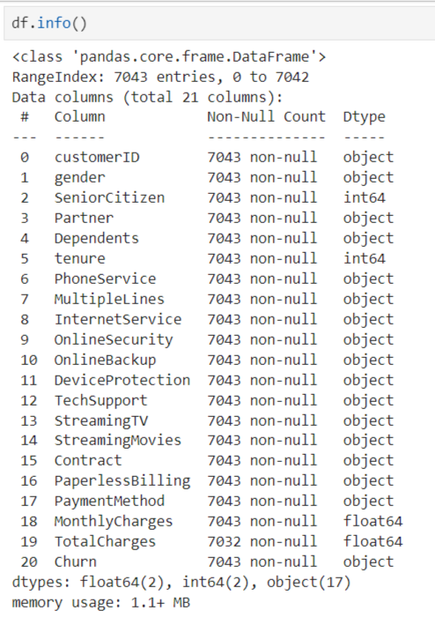
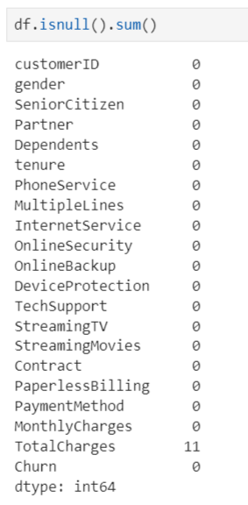
Analysis Approach
Methodology:
The following steps were conducted in this analysis.
Data Cleaning:
Missing values were handled to restore data completeness.

Slide 6
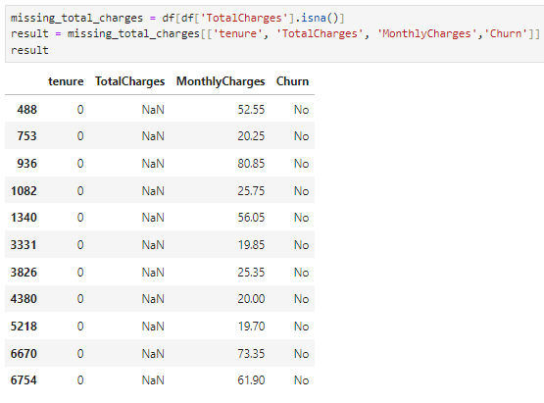
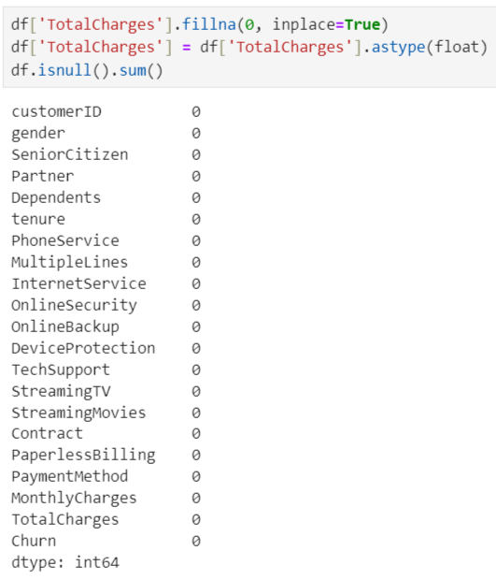
Data types were standardized to ensure that all variables are in appropriate formats, which is critical for analysis and modeling.

Slide 7
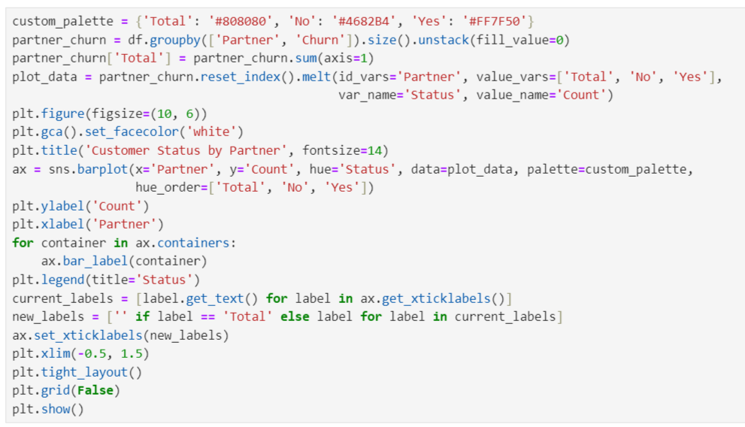
Categorical Columns Analysis:
Key categorical columns, such as Churn and Contract Type, were examined to identify customer churn preferences and patterns.

Slide 8
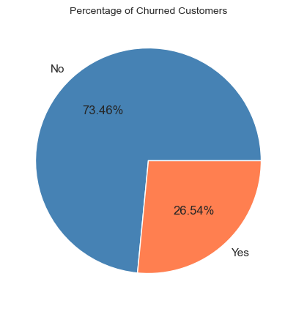
Visualization and Correlation Analysis:
Various graphs revealed potential relationships and patterns among the variables.
This pie chart shows that 26.54% of the company’s customers have discontinued their services (churned), while 73.46% remain active. This level of churn is significant and may indicate issues related to customer satisfaction or service conditions.

Slide 9
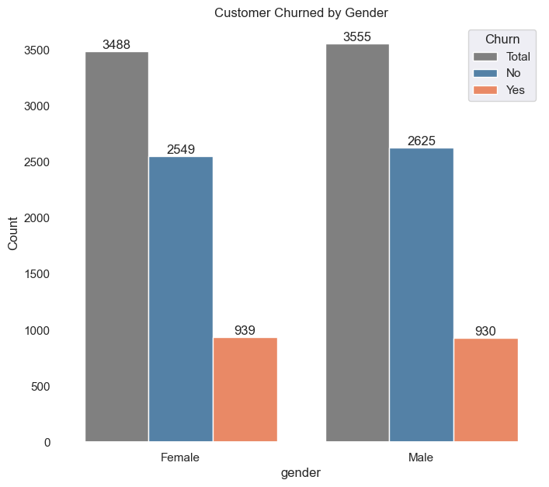
The plot below shows that churn for both genders is very similar.

Slide 10
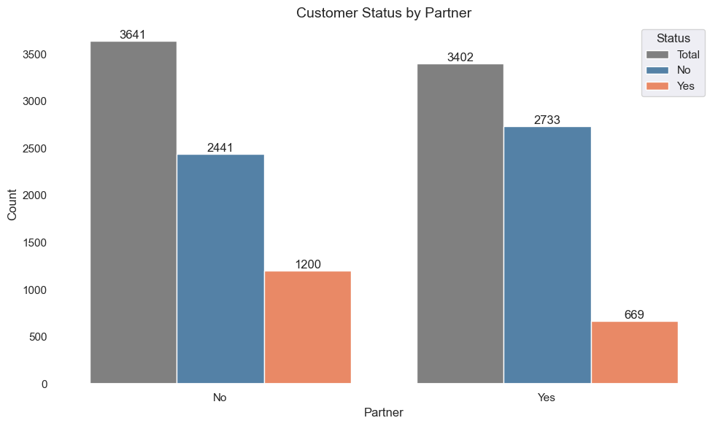
This graph shows customer churn based on partner status. Churn is higher among customers without a partner (1,200) compared to those with a partner (669). This suggests that customers with a partner are less likely to churn, providing a useful insight for developing targeted customer retention strategies.

Slide 11
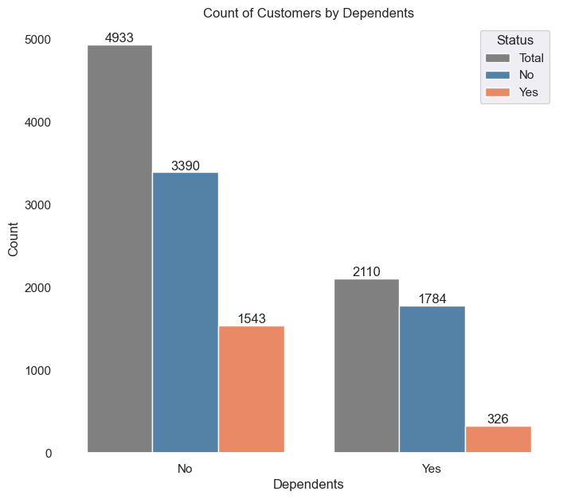
This graph displays customer churn based on the presence of dependents. Customers without dependents have a higher churn rate (1,543) compared to those with dependents (326).
This suggests that customers with dependents may be more likely to stay with the company, possibly valuing service stability and reliability more highly.

Slide 12
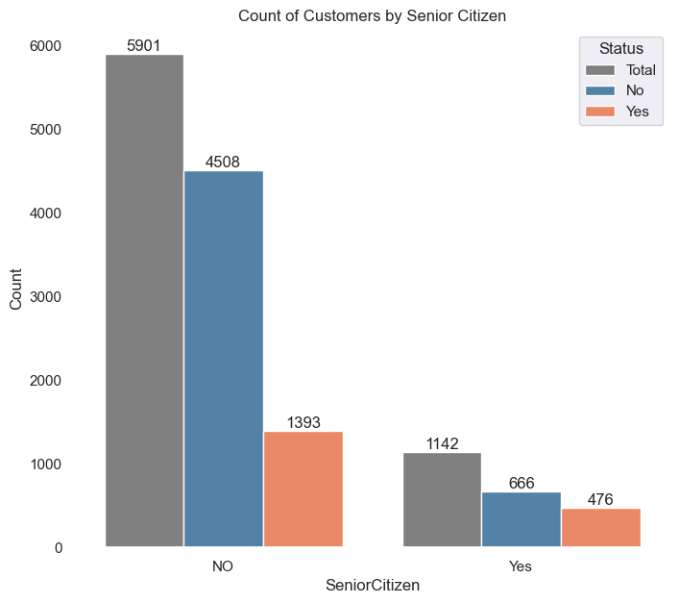
This graph shows the number of customers based on senior citizen status. Most customers are not seniors, with churn in this group reaching 1,393, while senior customer churn stands at 476.
This may indicate that seniors are relatively more likely to leave the service, although their overall numbers are smaller.

Slide 13
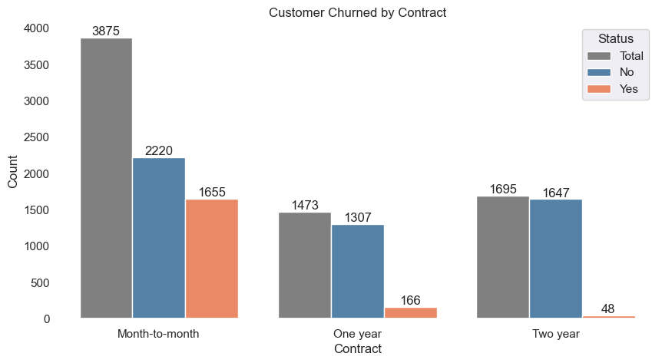
Churn rate for month-to-month contracts much higher that for other contract durations.

Slide 14
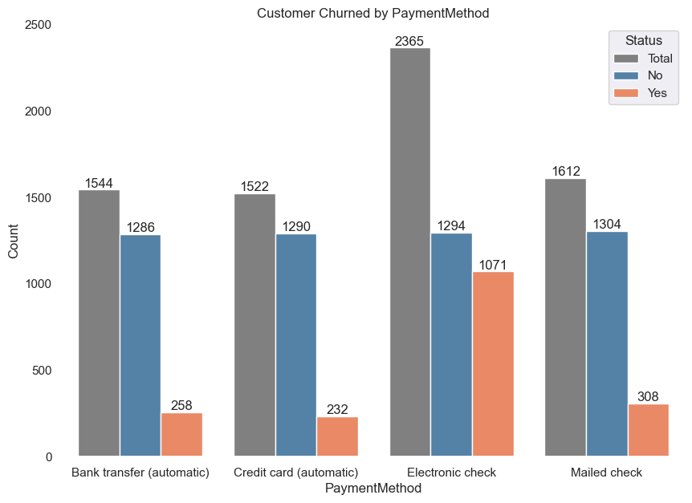
ElectronicCheck: Has the highest number of churn cases, indicating potential issues with this payment option.

Slide 15
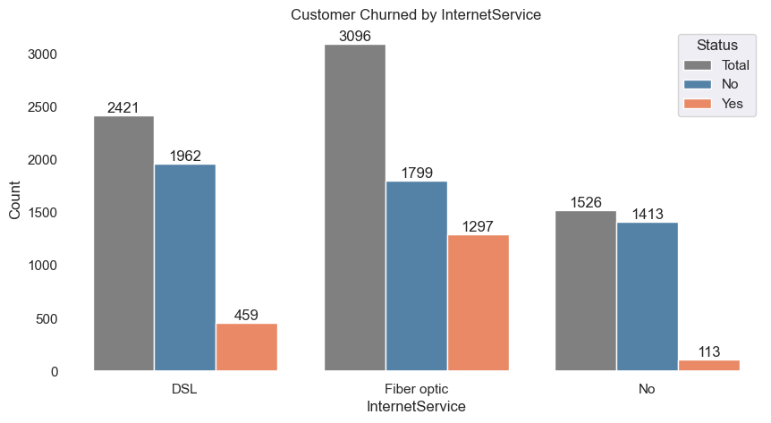
FiberOptic InternetService keeps more customers, however, it also has the highest number of churn cases compared to other internet service types.

Slide 16
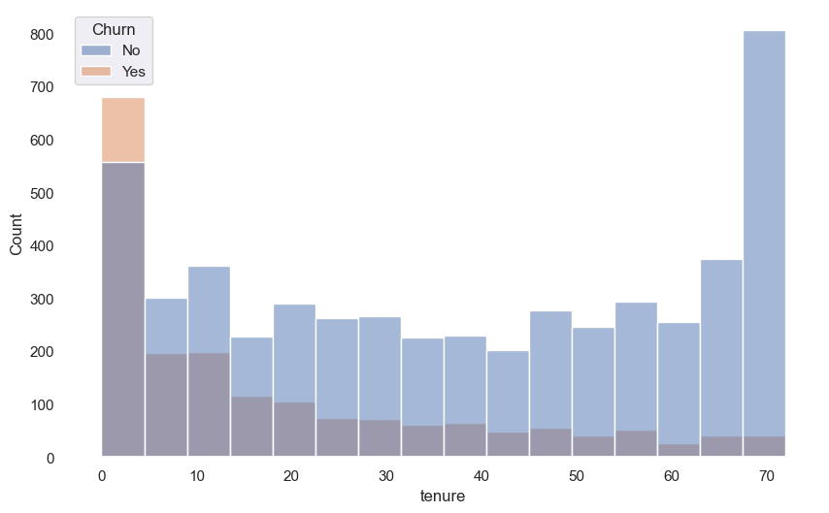
This graph presents customer churn statistics based on service tenure. It is clear that the highest churn rate is observed among customers with the shortest tenure (around 6 months). As tenure increases, the churn rate decreases, suggesting that long-term customers are more loyal. Churn cases are almost nonexistent among customers with the maximum tenure of 70 months.

Slide 17
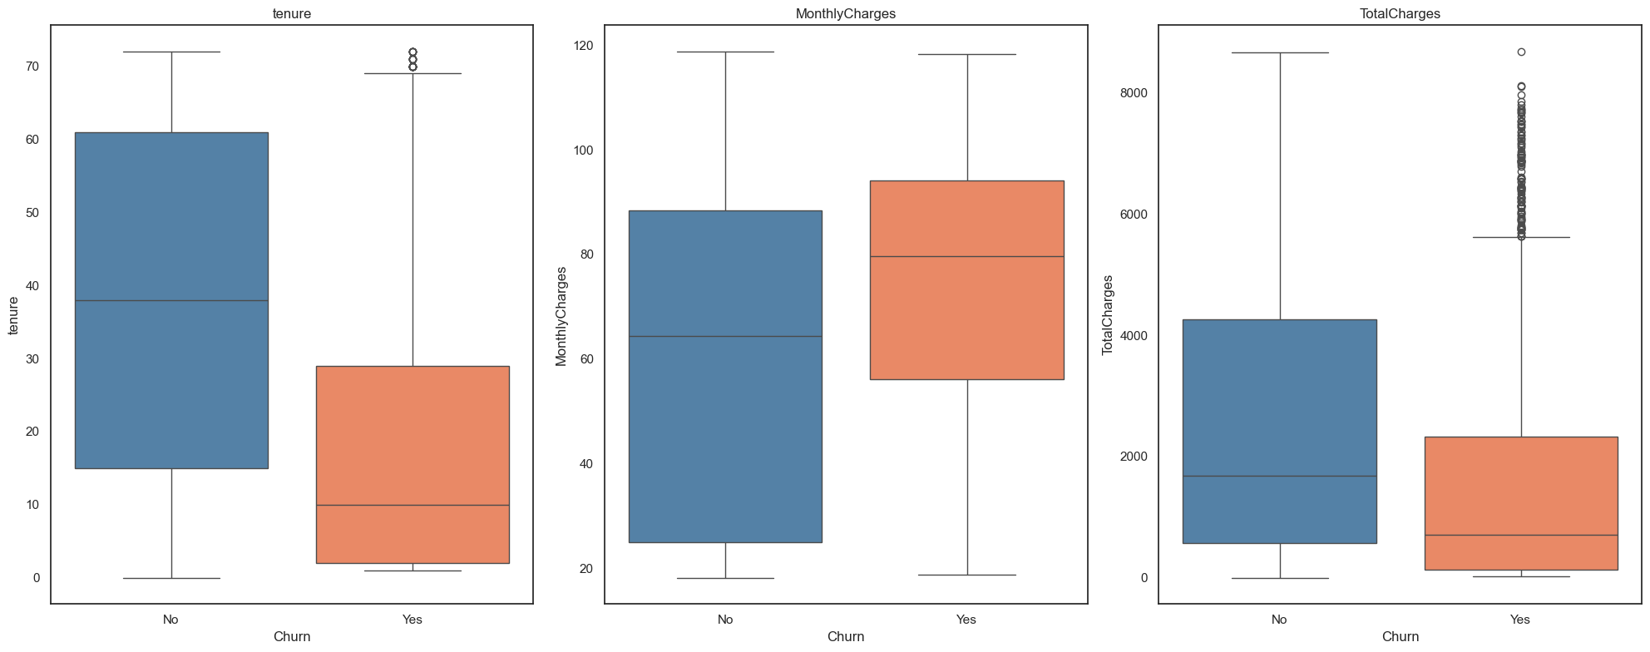
Churning customers have much lower tenure median compared to a median of non-churners.
Churning customers have higher monthly median charges and much lower interquartile range compared to that of non-churners.

Slide 18
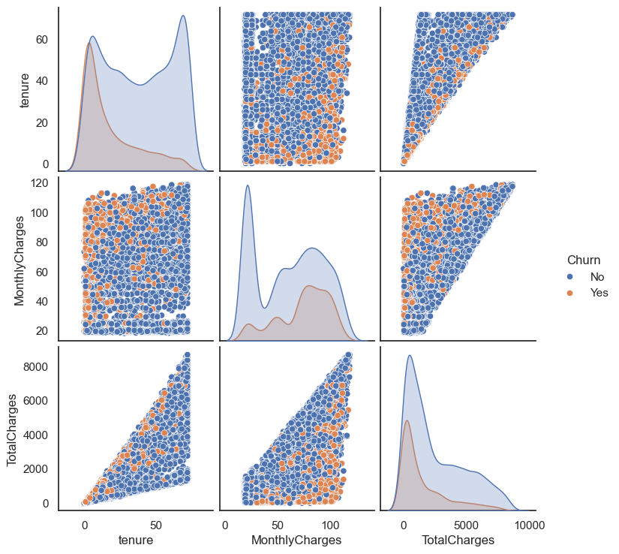
Observations:
Customer that has shorter time subscribe the service (smaller tenure) most likely to churn.
Customer with lower MonthlyCharges is most likely to stay, and the higher Monthly Charges is most likely to churn.
Interestingly, customers with lower TotalCharges is most likely to churn.

Slide 19
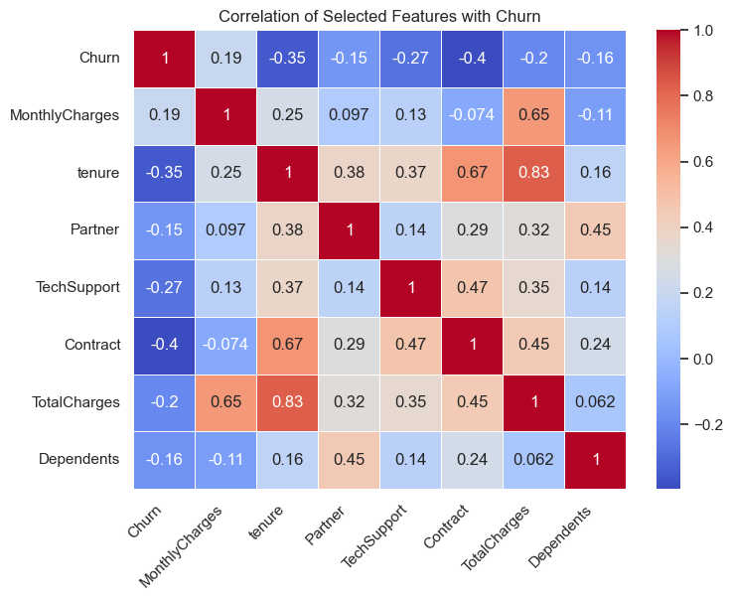
Tenure is highly (0.83) correlated to Total Charges but not to Monthly Charges (0.25).
However Monthly Charges and Total Charges are somehow correlated to each other but the correlation value is less than 0.83.

Slide 20
When we consider the Exploratory Data Analysis we did, it is clear that this company has some issue with their Month-to-month contracts.
Ultimately, these are questions best directed to your marketing team:
What incentives can the company offer to encourage customers to sign One-year or Two-year contracts?
What adjustments could make Month-to-Month contracts more appealing to customers without diminishing the value of longer-term contracts?

Slide 21

Key Focus Group for Retention Efforts:
1. Contract: Month-to-month,
2. Tenure: Short tenure,
3. Internet service: Fiber optic,
4. Payment method: Electronic check.
Limitations:
Data Constraints: The dataset may not cover all customer preferences and behaviors, limiting recommendation accuracy.
Time Period: Results may vary for other timeframes.

Slide 22

Now, let's move to the interactive dashboard I created using Plotly Dash.
This dashboard provides real-time insights and allows us to explore different aspects of the data visually. I've set it up on a Google Cloud server, so it’s accessible through a dedicated link for easy access: http://34.70.27.17:8050/

Slide 23
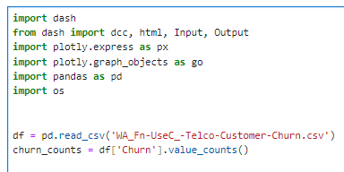
A quick overview of the main parts of the code and libraries:
Libraries and Data Integration: The code uses the dash and plotly libraries to create an interactive web application for visualizing customer churn data. dash serves as the framework for building the web app, while plotly is used to create various charts, such as pie, histogram, and bar charts.
Additionally, the data is loaded from a CSV file using pandas, which reads the file into a DataFrame (df).
This DataFrame acts as the main source of data for all the visualizations. Before plotting, the code performs some data preparation steps on the DataFrame, such as categorizing columns and transforming specific values for better analysis.

Slide 24
2. Data Loading and Preparation: The data is loaded from a CSV file, with transformations applied, such as converting the “SeniorCitizen” column to display values as "Yes" or "No." Unnecessary columns are excluded to streamline the analysis.

Slide 25
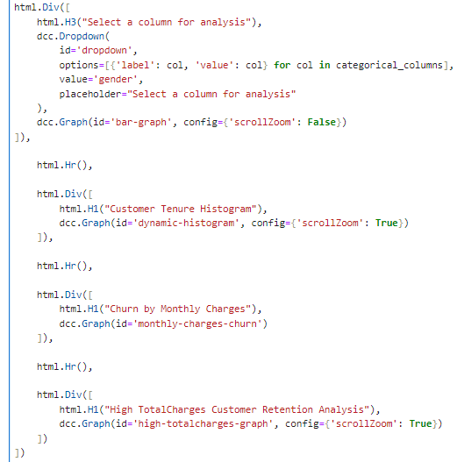
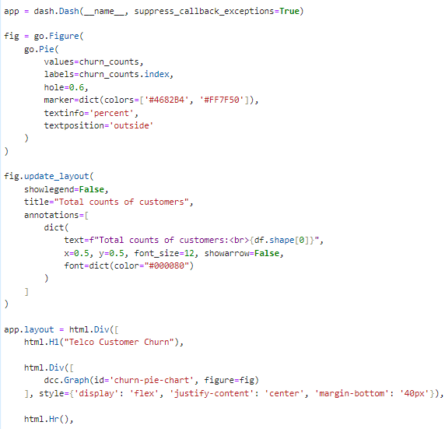
3. Key Visualizations:
Pie Chart: Displays the overall counts of customers by churn status.
Dynamic Histograms and Bar Charts: These visualizations allow users to explore the distribution of customers across different attributes, such as TotalCharges and MonthlyCharges, with adjustable bin sizes for finer analysis.

Slide 26
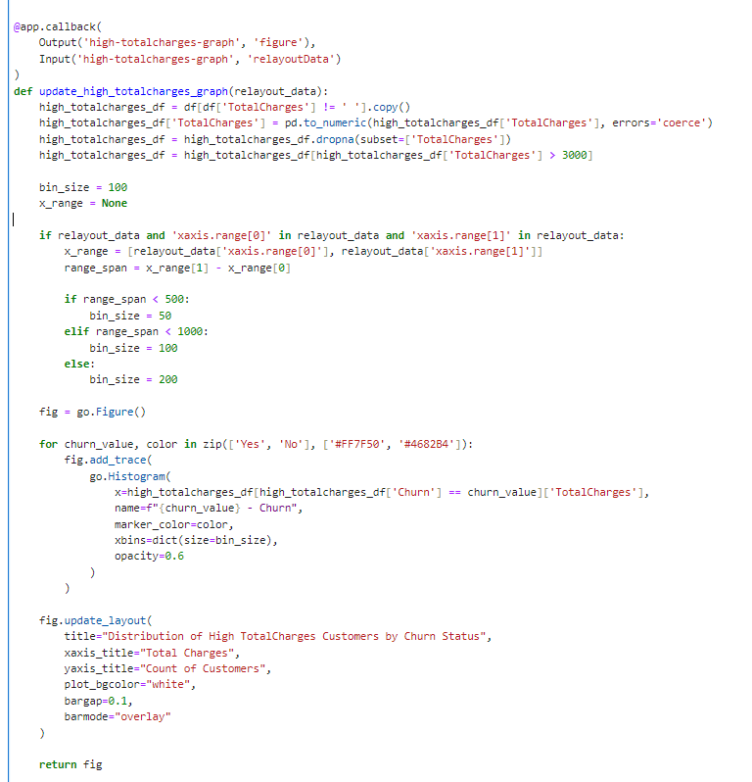
Callbacks and Interactivity: Callback functions are used to update the charts based on user selection in the interface (e.g., selecting a column for analysis).
These functions control bin sizes and ranges, enabling responsive and customizable charts depending on the data.

Slide 27

This code is used to start the Dash server and launch the web app.
Setting debug=True enables debug mode, which provides detailed error messages and automatically reloads the app during development when changes are made to the code.
Local Server Setup: The command app.run_server(debug=True) runs the Dash app on a local server, accessible at http://127.0.0.1:8050/.
The IP 127.0.0.1 points to the local machine, meaning only the computer running the code can access it by default. The port 8050 is the default for Dash, chosen because it’s not commonly used by other applications, reducing conflicts.

Slide 28
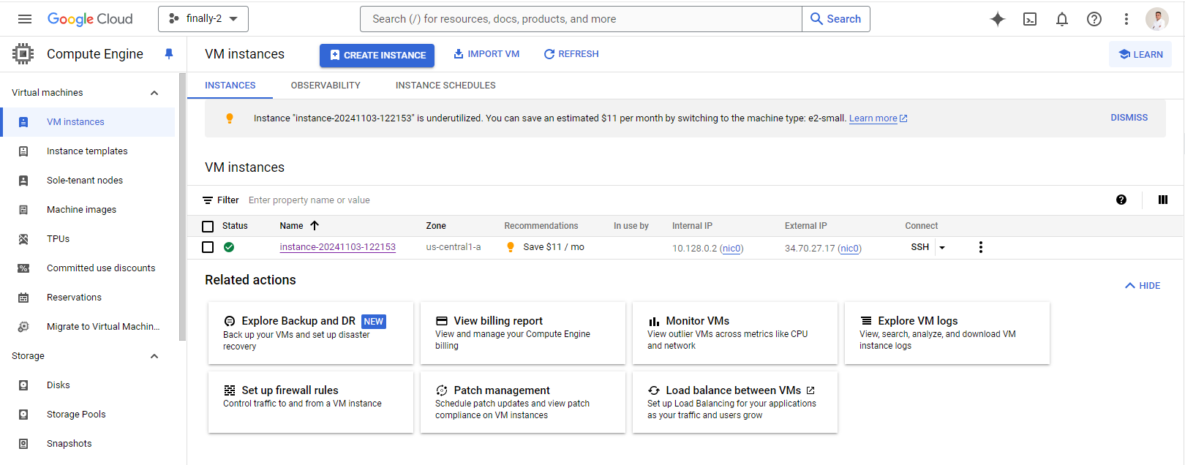
To make the dashboard accessible online, I deployed it on Google Cloud. This setup allows for remote access through a secure link, making it easy for team members and stakeholders to view and interact with the dashboard directly.
Here is a view of my Google Cloud Console, where the dashboard is hosted on a VM instance. This setup ensures the dashboard is accessible online through a specific link, allowing for real-time interaction with the churn analysis data. The VM instance’s configuration, including external IP, enables secure remote access for users to explore customer insights from anywhere.

Slide 29
Thanks for Your Attention

